Slide 1

Advance PostgreSQL – Part 1

Slide 2
Agenda
Constraints
Joins (Inner, Left and Right)
Sub Query
Aggregate Functions
Group By, Having
Indexes
Date & Time handling
EXISTS
CTE – Common Table Expressions
Window functions
Table Partitioning
Custom Types
UPSERT (INSERT __ ON CONFLICT DO UPDATE)
Notes:
2

Slide 3
Overview​
Welcome to this session on Advanced PostgreSQL, where we move beyond basics and focus on writing efficient, scalable, and real-world SQL queries.
What You’ll Learn
Constraints: PRIMARY KEY, FOREIGN KEY, UNIQUE, CHECK
Joins: INNER, LEFT, RIGHT
Joins vs Subqueries, EXISTS
Aggregate functions: COUNT, SUM, AVG, MIN, MAX
GROUP BY, HAVING for data analysis
CTEs (WITH) & Recursive CTEs
Indexes (intro) & Date/Time handling
Window functions: ROW_NUMBER, RANK, LAG, LEAD
Outcome: Build performance-optimized, interview-ready PostgreSQL queries with confidence.
Notes:
3

Slide 4
Constraints - Overview
Constraints are the rules applied to table columns to ensure data integrity and consistency.
Common Constraints
PRIMARY KEY
FOREIGN KEY
UNIQUE
CHECK
Constraints prevent invalid data from being inserted into tables.
Notes:
4

Slide 5
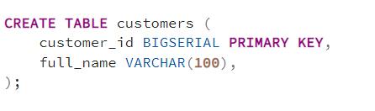
PRIMARY KEY
Uniquely identifies each row in a table
Cannot be NULL
One primary key per table
Automatically creates a unique index
Notes:
5

Slide 6
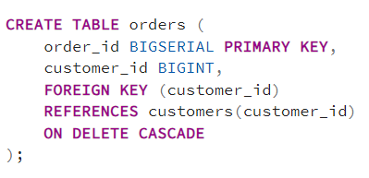
FOREIGN KEY - ON DELETE CASCADE
Deletes child rows automatically when parent is deleted.
Effect
Customer deleted
All related orders deleted
All related order_items deleted (multi-level cascade)
Notes:
6

Slide 7
FOREIGN KEY - ON DELETE
Option | Behavior
CASCADE | Delete child rows
RESTRICT | Block delete
NO ACTION | Same as restrict
SET NULL | FK becomes NULL
SET DEFAULT | FK → default value
Notes:
7

Slide 8
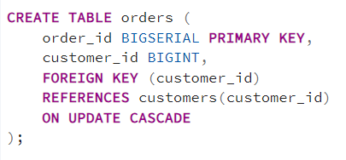
FOREIGN KEY - ON UPDATE CASCADE
Parent key update blocked
Effect
customers.customer_id updated
orders.customer_id updated automatically
Rarely used (PKs usually immutable)
Notes:
8

Slide 9
FOREIGN KEY - ON UPDATE
Option | Behavior (ON UPDATE)
CASCADE | Update child FK values
RESTRICT | Block parent update
NO ACTION | Same as RESTRICT
SET NULL | FK becomes NULL
SET DEFAULT | FK → default value
Notes:
9

Slide 10
FOREIGN KEY - Best Practices
Use CASCADE for dependent tables
Avoid cascading deletes on master data
Index foreign key columns
Review multi-level cascades carefully
Notes:
10

Slide 11
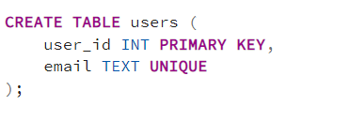
UNIQUE
Ensures all values in a column are unique
Allows NULL values (one or more)
Useful for emails, usernames, phone numbers
Notes:
11

Slide 12
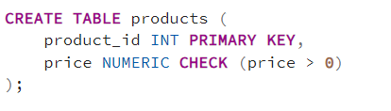
CHECK
Validate data based on condition.
Allows custom rules.
Prevents invalid values like negative prices
Notes:
12

Slide 13
Constraints - Summary
Constraint | Purpose | Allows NULL
PRIMARY KEY | Uniquely identify row | No
FOREIGN KEY | Maintain relationship | Yes
UNIQUE | Prevent duplicates | Yes
CHECK | Validate condition | Depends
Constraints protect your database from bad data and enforce business rules at the database level.
Notes:
13

Slide 14
SQL Joins - Overview
A JOIN is used to combine rows from two or more tables based on a related column.
Why Joins Matter
Fetch data spread across multiple tables
Maintain normalized database design
Build real-world queries (orders, customers, products)
Common Join Types
INNER JOIN
LEFT JOIN
RIGHT JOIN
Notes:
14

Slide 15
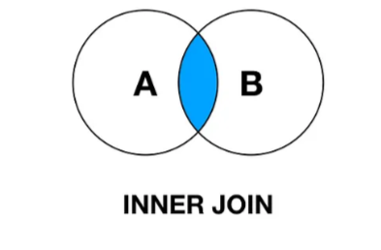
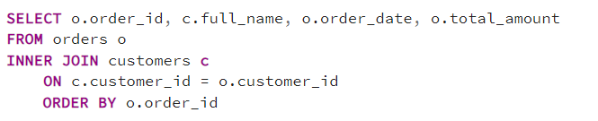
INNER JOIN
Returns only the rows where there is a matching value in both tables.
Syntax :
SELECT columns
FROM table1
INNER JOIN table2
ON condition;
Notes:
15

Slide 16
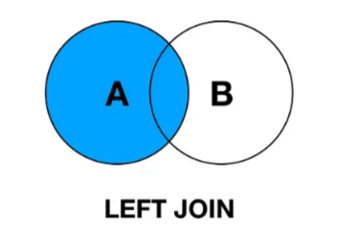
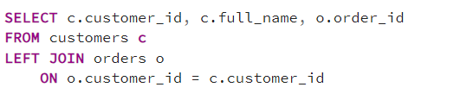
LEFT JOIN
Returns all rows from left table, and matching rows from the right table.
If no match => NULL
Syntax :
SELECT columns
FROM table1
LEFT JOIN table2
ON condition;
Notes:
16

Slide 17
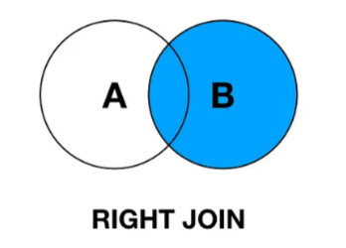
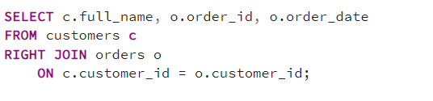
RIGHT JOIN
Returns all rows from right table, and matching rows from the left table.
If no match => NULL
Syntax :
SELECT columns
FROM table1
RIGHT JOIN table2
ON condition;
Notes:
17

Slide 18
Key Takeaways
JOINs combine data from multiple tables
INNER JOIN → matching rows only
LEFT JOIN → all left + matched right
RIGHT JOIN → all right + matched left
Always join on correct keys
Understand NULL behavior
Notes:
19

Slide 19
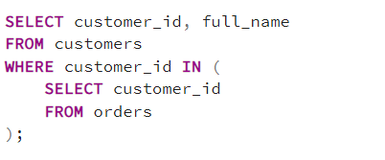
Subquery
A subquery is a query nested inside another SQL query, executed first, and its result is used by the outer query.
When to Use Subqueries
Filtering results
Existence checks (EXISTS)
When JOIN is not required for output columns
Notes:
20

Slide 20
Join vs subquery
Feature | JOIN | Subquery
Purpose | Combine tables | Filter or condition
Readability | Better for relationships | Better for logic
Performance | Usually faster | Can be slower
Output Columns | From multiple tables | From main table
Use Case | Reporting, analytics | Validation, conditions
Notes:
21

Slide 21
What Are Aggregate Functions?
Aggregate functions perform calculations on multiple rows and return a single result value.
Common Aggregate Functions
COUNT() – Counts rows
SUM() – Adds numeric values
AVG() – Calculates average
MIN() – Finds minimum value
MAX() – Finds maximum value
- Commonly used with GROUP BY for data analysis.
Notes:
22

Slide 22

COUNT()
COUNT() returns the number of rows that match a condition.
Syntax :
  COUNT(column_name)
  COUNT(*)
Notes:
23

Slide 23

SUM()
SUM() calculates the total of a numeric column.
Syntax :
  SUM(column_name)
Notes:
24

Slide 24

AVG()
AVG() returns the average value of a numeric column.
Syntax :
  AVG(column_name)
Notes:
25

Slide 25

MIN()
MIN() returns the smallest value in a column.
Syntax :
  MIN(column_name)
Notes:
26

Slide 26

MAX()
MAX() returns the largest value in a column.
Syntax :
  MAX(column_name)
Notes:
27

Slide 27
GROUP BY & HAVING - Overview
Used to aggregate data and filter grouped results.
GROUP BY → Groups rows
HAVING → Filters aggregated data
Commonly used with aggregate functions like COUNT, SUM, AVG
Notes:
28

Slide 28


GROUP BY
GROUP BY groups rows that have the same values into summary rows.
Syntax :
SELECT column, aggregate_function()
FROM table
GROUP BY column;
Notes:
29

Slide 29
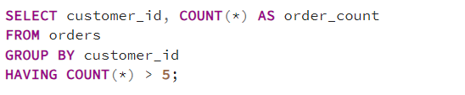
HAVING
HAVING filters grouped results after aggregation.
WHERE → filters rows
HAVING → filters groups
Notes:
30

Slide 30
GROUP BY & HAVING – key Points
GROUP BY is used with aggregate functions
HAVING filters aggregated results
WHERE filters rows before grouping
Often used together for analytics queries
Notes:
31

Slide 31
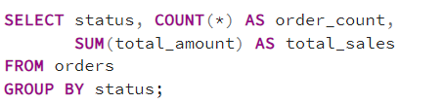
Aggregate Function with GROUP BY
Used to apply aggregate functions per group.
Without GROUP BY, aggregate functions return one row only
Notes:
32

Slide 32
Key Points to Remember
Aggregate functions return single values
GROUP BY is required when selecting non-aggregated columns
NULL values are ignored (except COUNT(*))
Often combined with HAVING for filtering aggregated data
Notes:
33

Slide 33
Indexes
An index is a database structure that improves query performance by allowing faster data retrieval.
Similar to an index in a book — it helps find data quickly without scanning the entire table.
Without Index
  Full table scan
  Slower queries on large tables
With Index
  Faster SELECT queries
  Efficient filtering & sorting
Indexes speed up:
  WHERE
  JOIN
  ORDER BY
  GROUP BY
Notes:
34

Slide 34

How Index Works
Index stores column values + row references
Query planner uses index to locate rows quickly
Reduces disk I/O
  PostgreSQL mainly uses B-Tree indexes by default
When to Create
Frequently used in WHERE
Used in JOIN conditions
Large tables
Notes:
35

Slide 35
Why Indexes Matter
Without index:
  Sequential scan
  Slow on large tables
  With index:
  Index scan
  Faster lookups
Indexes improve:
  WHERE
  JOIN
  ORDER BY
  GROUP BY
Notes:
36

Slide 36

B-Tree Index (Default)
Most Common Index
  Equality (=)
  Range (> < BETWEEN)
  Sorting (ORDER BY)
Notes:
37

Slide 37

Hash Index
Equality Only
  = comparisons
  No range queries
Rarely used
B-tree usually preferred
Notes:
38

Slide 38
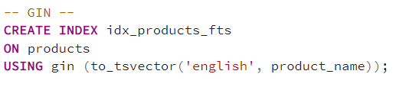
GIN Index (Generalized Inverted Index)
For Complex Data Types
  Full-Text Search
  ARRAY, JSONB
  @>, ?, @@
Very fast search
Larger index size
Notes:
39

Slide 39
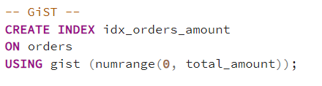
GisT Index (Generalized Search Tree)
For Range and Geometry
  Range types
  Geospatial data
  Nearest-neighbor search
Used in PostGIS
Flexible Indexing
Notes:
40

Slide 40
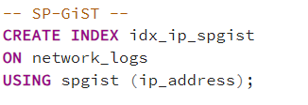
SP-GisT Index
Hierarchical & Partitioned Data
  Trees
  IP ranges
  Phone numbers
Specialized use
Not common in apps
Notes:
41

Slide 41
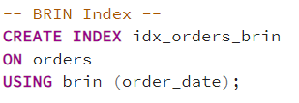
BRIN Index (Block Range Index)
For Huge tables
  Time-series data
  Sequential data
  Minimal storage
Very small index
Less precise then b-tree
Notes:
42

Slide 42
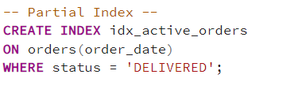
Partial Index
Index Only Needed Rows
Faster
Smaller index
Highly optimized
Best for filtered queries
Notes:
43

Slide 43
Expression Index
Index on function result
Faster
Smaller index
Highly optimized
Best for filtered queries
Notes:
44

Slide 44
Index Type Comparison
Index Type | Use Case | Fast | Size
B-Tree | General | ✅ | Medium
Hash | Equality | ⚠️ | Small
GIN | JSON / Array / FTS | ✅ | Large
GiST | Geo / Range | ✅ | Medium
SP-GiST | Hierarchy | ⚠️ | Medium
BRIN | Huge tables | ⚠️ | Tiny
Partial | Filtered data | ✅ | Small
Expression | Functions | ✅ | Medium
Notes:
45

Slide 45
When Index is NOT Used
Small tables
LIKE '%abc%'
Columns with frequent updates
Low-selectivity columns
(e.g., gender)
Indexes improve reads but slow down writes
Notes:
46

Slide 46
Date & Time Handling - Overview
Date & Time handling is essential for:
Tracking events
Reporting & analytics
Time-based filtering
PostgreSQL provides powerful built-in date & time functions.
Common Data Types
DATE → Stores date only
TIME → Stores time only
TIMESTAMP → Date + time (without timezone)
TIMESTAMPTZ → Date + time with timezone
Notes:
47

Slide 47
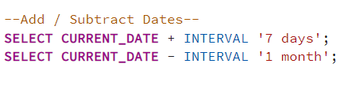
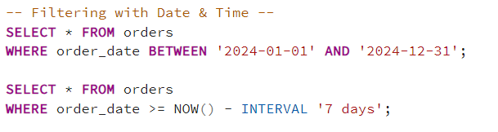
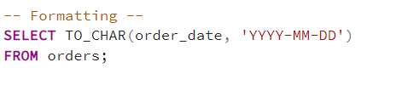
Query with Date
Common Formats
YYYY-MM-DD
DD-MM-YYYY
Month YYYY
Notes:
48

Slide 48
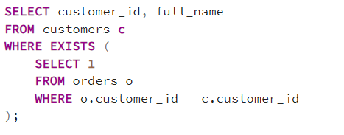
EXISTS
EXISTS returns TRUE if the subquery returns at least one row.
Syntax :
SELECT column
FROM table
WHERE EXISTS (subquery);
Stops execution once a match is found
Faster than IN for large datasets
Notes:
49

Slide 49
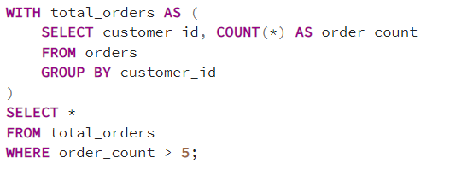
CTE (WITH)
A Common Table Expression is a temporary result set used within a query.
Syntax :
WITH cte_name AS (
SELECT ...
)
SELECT *
FROM cte_name;
Improves readability & maintainability
Notes:
50

Slide 50
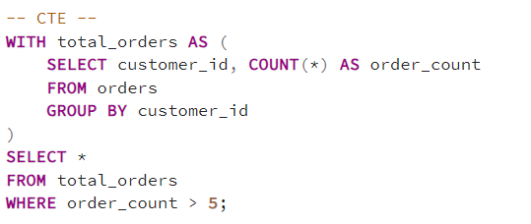
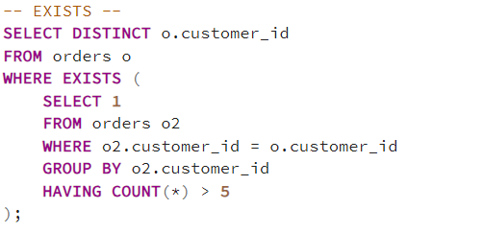
EXISTS vs CTE
Feature | EXISTS | CTE
Purpose | Check existence | Reusable query block
Returns | TRUE / FALSE | Result set
Use Case | Filtering | Complex queries
Readability | Medium | High
Notes:
51

Slide 51
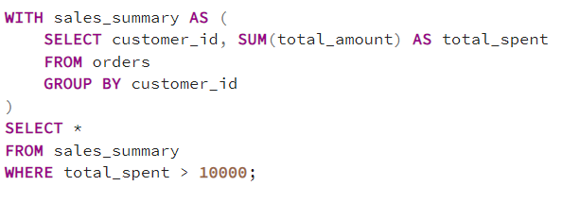
Advanced CTEs
Advanced CTEs are used to:
Break complex queries into steps
Improve readability & maintainability
Handle hierarchical or recursive data
Common in reporting, analytics, and tree-structured data
Use Cases
Reusing aggregated results
Simplifying complex joins
Layered calculations
Acts like a temporary table
Exists only for the query execution
Notes:
52

Slide 52
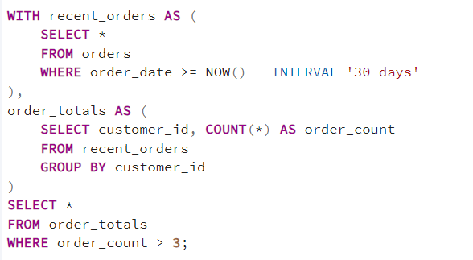
Multiple CTEs in One Query
CTEs can reference previous CTEs
Notes:
53

Slide 53
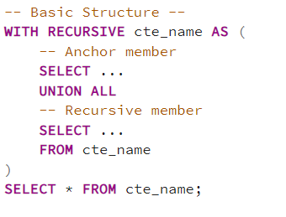
Recursive CTEs
A recursive CTE is used to query hierarchical or tree-structured data.
Common Use Cases
Employee-manager hierarchy
Category-subcategories
Organizational charts
UNION ALL is mandatory
Anchor query runs first
Notes:
54

Slide 54
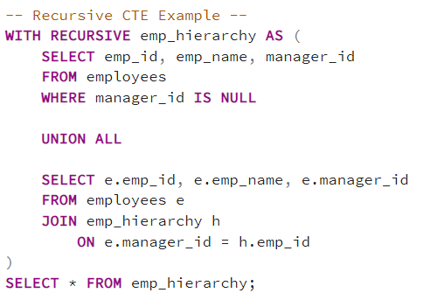
Key Points & Best Practices
Use CTEs to simplify complex SQL
Recursive CTEs handle hierarchical data
Avoid infinite recursion (ensure termination)
Prefer CTEs for readability over subqueries
Notes:
55

Slide 55
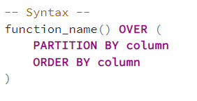
Window Function - Overview
Window functions perform calculations across a set of rows without collapsing rows.
Unlike GROUP BY, window functions preserve row-level data
Common Window Functions
ROW_NUMBER()
RANK()
LAG()
LEAD()
PARTITION BY → groups rows
ORDER BY → defines row order
Notes:
56

Slide 56
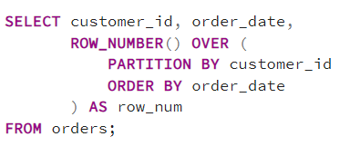
ROW_NUMBER()
Assigns a unique sequential number to each row.
Useful for pagination and deduplication
Notes:
57

Slide 57
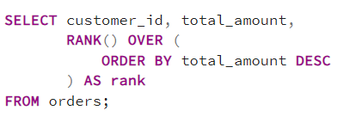
RANK()
Assigns ranks with gaps for duplicate values.
Tied values get same rank, next rank is skipped
Notes:
58

Slide 58
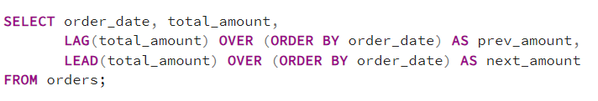
LAG() & LEAD()
LAG() → Access previous row value
LEAD() → Access next row value
Used for trend analysis & comparisons
Notes:
59

Slide 59
Partitioning & Large Tables
Why Partitioning?
When a table becomes very large (millions/billions of rows), queries, inserts, updates, and deletes can become slow.
Partitioning splits a large table into smaller, more manageable pieces (partitions), while logically behaving as a single table.
Benefits:
Faster queries (by scanning only relevant partitions).
Better maintenance (VACUUM, ANALYZE, REINDEX only on smaller partitions).
Easier data lifecycle management (drop/archive old partitions).
Parallel query execution.
Partitioning Types:
Range Partitioning
List Partitioning
Hash Partitioning
Composite Partitioning (Sub-Partitioning)
Notes:
60

Slide 60
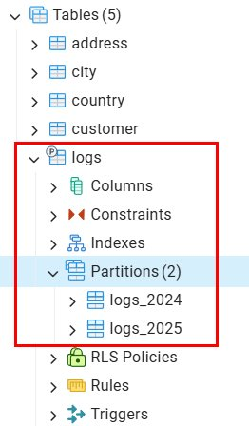
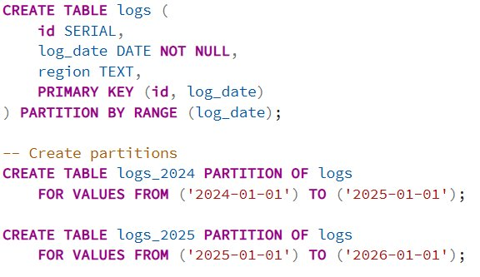
Partitioning Types: Range
Combination of partitioning methods (e.g., range + list).​
When you create a PRIMARY KEY or UNIQUE constraint on a partitioned table, all partitioning columns must be included in the key.​
Notes:
61

Slide 61
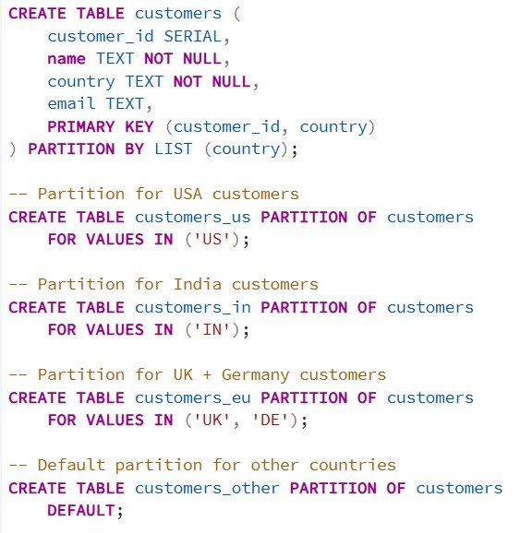
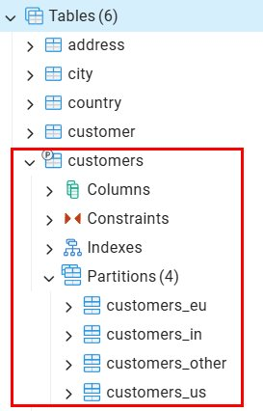
Partitioning Types: List
In List Partitioning, rows are distributed into partitions based on discrete values of a column (or expression).
Example: country = 'US', country = 'IN'
Great for categorical data like country, department, product type, status.
Notes:
62

Slide 62
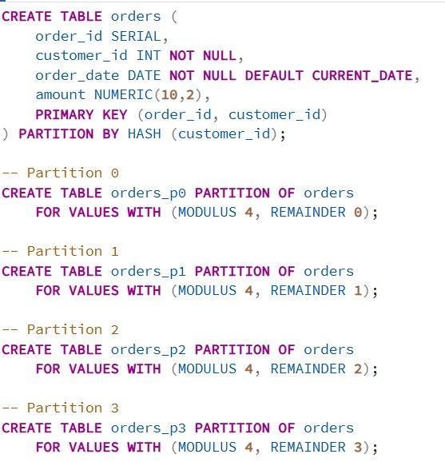
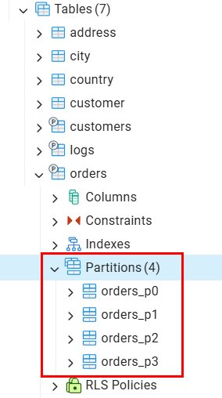
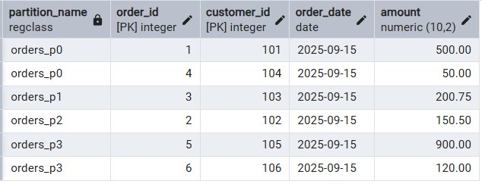
Partitioning Types: Hash
Rows are distributed to partitions based on the hash value of a column.
Ensures even distribution of data (good for parallel queries, load balancing).
Unlike range/list partitioning, you don’t control which specific values go to which partition.
Useful when no natural ranges exist, but you want to avoid a single “hot” partition.
Notes:
63

Slide 63
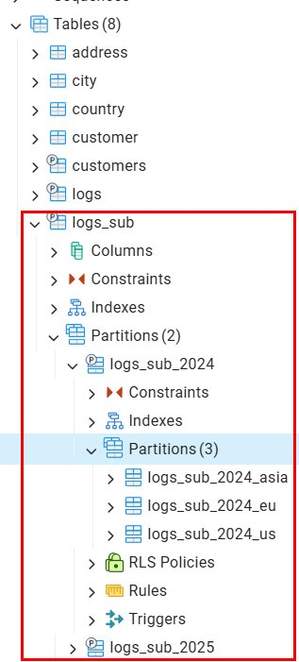
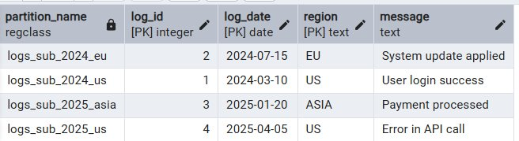
Partitioning Types: Composite
A table is partitioned on more than one level.
First partition by one method (e.g., Range), and inside each partition, further sub-partition (e.g., List or Hash).
Great for multi-dimensional data → e.g., time-series (by date) + region (by list).
Where Composite Partitioning Helps?
Multi-dimensional partitioning → e.g., time + geography.
Faster queries → PostgreSQL prunes both date and region partitions.
Easier data management (drop partitions per year or per region).
Notes:
64

Slide 64
Best Practices & Key Takeaways
Best Practices :
  Always partition on query filter column
  Prefer RANGE for dates
  Keep partition sizes balanced
  Avoid too many partitions
Key Takeaways :
  Partitioning is essential for large tables
  Improves query speed & maintenance
  Best suited for time-series data
  Works seamlessly with your existing schema
Notes:
65

Slide 65
Custom Types
Custom types allow you to define your own data types in PostgreSQL.
Why Use Custom Types?
Enforce consistent data values
Improve data readability
Reduce data errors
Centralize business rules
- Commonly used for statuses, categories, structured data
Notes:
66

Slide 66
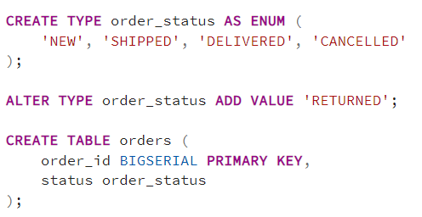
ENUM Type
ENUM restricts a column to predefined values only.
Notes:
67

Slide 67
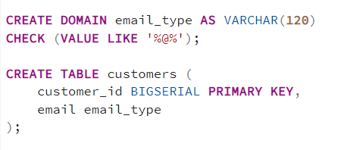
Domain Type
A DOMAIN is a custom data type with constraints.
Reusable validation logic
Notes:
68

Slide 68
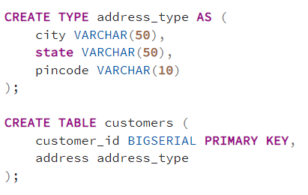
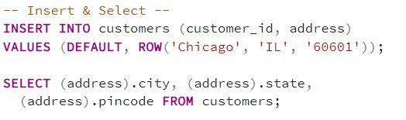
Composite Type
A composite type groups multiple fields into one type.
Useful for structured data.
Notes:
69

Slide 69
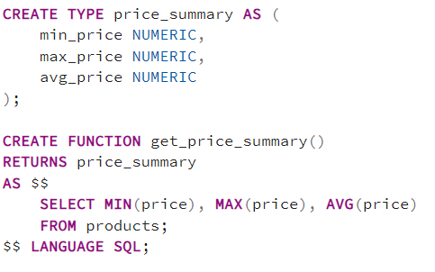
Composite Type in Function
A composite type groups multiple fields into one type.
Improves function return clarity
Notes:
70

Slide 70
When to use & Key Takeaways
Best Use Cases
  Status fields (ENUM)
  Reusable validation (DOMAIN)
  Structured columns (COMPOSITE)
  Function return types
Key Takeaways
Custom types improve data integrity
ENUM enforces fixed values
DOMAIN adds reusable constraints
COMPOSITE types group related fields
Makes schemas cleaner & safer
Notes:
71

Slide 71
UPSERT
UPSERT allows you to insert a new row or update an existing row if a conflict occurs
- Introduced in PostgreSQL 9.5
- Prevents duplicate key errors
Use Cases
Avoid duplicate records
Maintain latest data
Idempotent inserts
Notes:
72

Slide 72
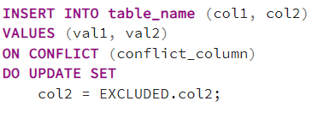
Why Use UPSERT?
INSERT fails on duplicate key
Requires separate SELECT + INSERT/UPDATE
Solution :
INSERT ... ON CONFLICT
- Single atomic operation
- Safe for concurrent inserts
Notes:
73

Slide 73
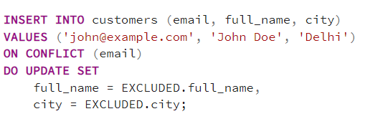

UPSERT Query
Inserts new customer
Updates existing customer if email exists
No error, no update
Notes:
74

Slide 74

UPSERT with WHERE Condition
Updates only when data changes
Notes:
75

Slide 75
Conflict Target Options
Conflict Target | Example
Column | ON CONFLICT (email)
Constraint | ON CONFLICT ON CONSTRAINT users_email_key
Composite Key | ON CONFLICT (col1, col2)
Requires a UNIQUE or PRIMARY KEY
Notes:
76

Slide 76
UPSERT Key Takeaways
UPSERT = Insert or Update
Uses ON CONFLICT
EXCLUDED represents incoming data
Requires UNIQUE / PRIMARY KEY
Safe & efficient for concurrent writes
Notes:
77

Slide 77
THANK YOU
ANY QUESTIONS ?
Notes:
78

